Slide 1


Maximising Algorithm Performance in .NET: Levenshtein Distance
James Turner
@MrTurnerj
Notes:
Hey, I’m James Turner and this presentation is all about maximising performance on an algorithm in .NET.
Our goal today is to make an extremely fast Levenshtein Distance calculator capable of handling very large strings.

Slide 2
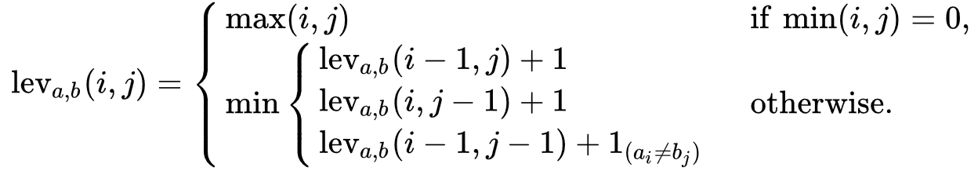
What is Levenshtein Distance?
Answers the question: How similar are two strings?
A smaller “distance” means fewer differences between two strings
Mathematical formula:
Notes:
Created by Vladimir Levenshtein, the Levenshtein Distance algorithm helps answer the question: how similar are two strings.
The smaller the distance, the fewer differences there are.
The algorithm does this by iterating over the characters in two strings, identifying edit costs depending on the operation performed.

Slide 3
Applications of Levenshtein Distance
Spell checking
Optical Character Recognition (OCR)
Plagiarism detection
Speech recognition
File comparison
Malicious site detection
DNA analysis
Computer forensics
Notes:
There are a few different applications for Levenshtein Distance.
Working with smaller strings, you can identify how similar 2 words are, useful for spell checking suggestions.
For larger strings, you might be comparing 2 files, useful for things like plagiarism detection.

Slide 4
Calculating the distance
Let’s calculate the distance between “Saturday” and “Sunday”
 |  | S | a | t | u | r | d | a | y
 | 0 | 1 | 2 | 3 | 4 | 5 | 6 | 7 | 8
S | 1
u | 2
n | 3
d | 4
a | 5
y | 6
Notes:
Calculating the Levenshtein Distance of two strings is a relatively straight forward process.
In this example, we will calculate the distance between “Saturday” and “Sunday”.
Imagine a matrix with the letters of these words making the columns and rows.

Slide 5
Calculating the distance
The cell with the hash (#) is the first cell we calculate
The left cell represents insertion costs
The cell above represents deletion costs
The top-left cell represents substitution costs
 |  | S | a | t | u | r | d | a | y
 | 0 | 1 | 2 | 3 | 4 | 5 | 6 | 7 | 8
S | 1 | #
u | 2
n | 3
d | 4
a | 5
y | 6
Notes:
The algorithm operates on a cell-by-cell basis.
The cell with the hash symbol is the first cell we calculate.

Slide 6
Calculating the distance
The cell with the hash (#) is the first cell we calculate
The left cell represents insertion costs
The cell above represents deletion costs
The top-left cell represents substitution costs
 |  | S | a | t | u | r | d | a | y
 | 0 | 1 | 2 | 3 | 4 | 5 | 6 | 7 | 8
S | 1 | #
u | 2
n | 3
d | 4
a | 5
y | 6
Notes:
The left cell represents the insertion costs.

Slide 7
Calculating the distance
The cell with the hash (#) is the first cell we calculate
The left cell represents insertion costs
The cell above represents deletion costs
The top-left cell represents substitution costs
 |  | S | a | t | u | r | d | a | y
 | 0 | 1 | 2 | 3 | 4 | 5 | 6 | 7 | 8
S | 1 | #
u | 2
n | 3
d | 4
a | 5
y | 6
Notes:
The cell above represents deletion costs.

Slide 8
Calculating the distance
The cell with the hash (#) is the first cell we calculate
The left cell represents insertion costs
The cell above represents deletion costs
The top-left cell represents substitution costs
 |  | S | a | t | u | r | d | a | y
 | 0 | 1 | 2 | 3 | 4 | 5 | 6 | 7 | 8
S | 1 | #
u | 2
n | 3
d | 4
a | 5
y | 6
Notes:
And the top-left cell represents substitution costs.
We use these different cells together to find the value for our current cell.

Slide 9
Calculating the distance
Take the minimum of the of the insertion and deletion costs, adding 1 to the result MIN(1, 1) + 1 = 2
 |  | S | a | t | u | r | d | a | y
 | 0 | 1 | 2 | 3 | 4 | 5 | 6 | 7 | 8
S | 1 | #
u | 2
n | 3
d | 4
a | 5
y | 6
Notes:
We start by taking the minimum value of the insertion and deletion costs for our cell, adding 1 to the result.
This gives us the value 2.

Slide 10
Calculating the distance
Take the substitution cost, adding 1 to the result IF the characters in the row/column don’t match 0 + (‘S’ != ‘S’ ? 1 : 0) = 0
 |  | S | a | t | u | r | d | a | y
 | 0 | 1 | 2 | 3 | 4 | 5 | 6 | 7 | 8
S | 1 | #
u | 2
n | 3
d | 4
a | 5
y | 6
Notes:
We then take the substitution cost for this cell, adding 1 if the corresponding characters in the row and column don’t match. The letters in this row and column are both the capital letter “S” so we don’t add 1, leaving us with the value 0.

Slide 11
Calculating the distance
The final value is the minimum of these two calculations MIN(2, 0) = 0
 |  | S | a | t | u | r | d | a | y
 | 0 | 1 | 2 | 3 | 4 | 5 | 6 | 7 | 8
S | 1 | 0
u | 2
n | 3
d | 4
a | 5
y | 6
Notes:
Finally for this cell, we take the minimum value of the two other numbers we just calculated.
This means the value for our current cell is 0.

Slide 12
Calculating the distance
This process now repeats for the next
New costs for this cell
Insertion cost: 0
Deletion cost: 2
Substitution cost: 1
 |  | S | a | t | u | r | d | a | y
 | 0 | 1 | 2 | 3 | 4 | 5 | 6 | 7 | 8
S | 1 | 0 | #
u | 2
n | 3
d | 4
a | 5
y | 6
Notes:
We repeat this process for the next cell in the row.
We have an insertion cost of 0, a deletion cost of 2 and a substitution cost of 1.

Slide 13
Calculating the distance
This process now repeats for the next
New costs for this cell
Insertion cost: 0
Deletion cost: 2
Substitution cost: 1
 |  | S | a | t | u | r | d | a | y
 | 0 | 1 | 2 | 3 | 4 | 5 | 6 | 7 | 8
S | 1 | 0 | 1
u | 2
n | 3
d | 4
a | 5
y | 6
Notes:
Following that same formula on the previous slides, this gives us the result of 1.

Slide 14
Calculating the distance
This calculation repeats for the rest of the row
 |  | S | a | t | u | r | d | a | y
 | 0 | 1 | 2 | 3 | 4 | 5 | 6 | 7 | 8
S | 1 | 0 | 1 | 2 | 3 | 4 | 5 | 6 | 7
u | 2
n | 3
d | 4
a | 5
y | 6
Notes:
We repeat this process for every cell in the row.

Slide 15
Calculating the distance
And then for every row left in the table
The Levenshtein Distance is the value in the final cell
 |  | S | a | t | u | r | d | a | y
 | 0 | 1 | 2 | 3 | 4 | 5 | 6 | 7 | 8
S | 1 | 0 | 1 | 2 | 3 | 4 | 5 | 6 | 7
u | 2 | 1 | 1 | 2 | 2 | 3 | 4 | 5 | 6
n | 3 | 2 | 2 | 2 | 3 | 3 | 4 | 5 | 6
d | 4 | 3 | 3 | 3 | 3 | 4 | 3 | 4 | 5
a | 5 | 4 | 3 | 4 | 4 | 4 | 4 | 3 | 4
y | 6 | 5 | 4 | 4 | 5 | 5 | 5 | 4 | 3
Notes:
And repeat that for every row in the table.
The Levenshtein Distance is found in the last cell in the bottom right corner.
This means that the Levenshtein Distance for “Saturday” and “Sunday” is 3.

Slide 16
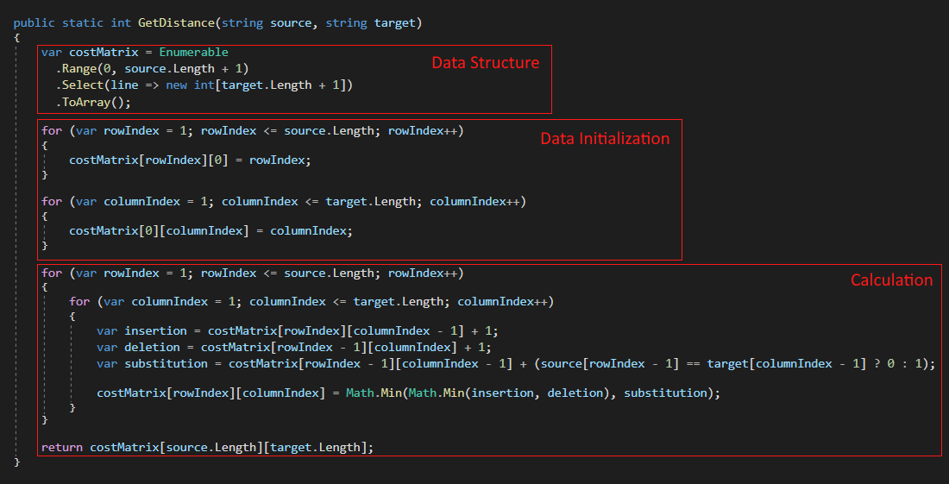
Our baseline
Notes:
This is our baseline implementation in C# which we will iteratively build upon throughout this presentation.
There are 3 essential elements to our baseline – the data structure, data initialization and the main calculation logic.

Slide 17
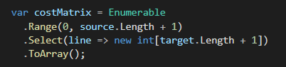
Our baseline – The data structure
 |  | S | a | t | u | r | d | a | y
S
u
n
d
a
y
Creates a jagged array (an array of arrays)
Uses LINQ
Space complexity: O((n+1)²)
Notes:
Starting with the data structure – we are creating a jagged array of integers via LINQ.
This structure mimics the same way we visualised the calculation in earlier slides – a full matrix of rows and columns.

Slide 18
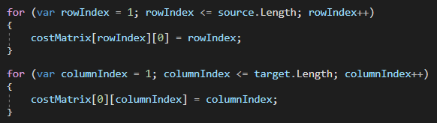
Our baseline – Data initialization
 |  | S | a | t | u | r | d | a | y
 | 0 | 1 | 2 | 3 | 4 | 5 | 6 | 7 | 8
S | 1
u | 2
n | 3
d | 4
a | 5
y | 6
First loop initializes only the first column
Second loop initializes only the first row
Notes:
Next is the data initialization – we need to setup the first row and first column so we can calculate the data.
The first loop handles the first column while the second loop handles the first row.

Slide 19
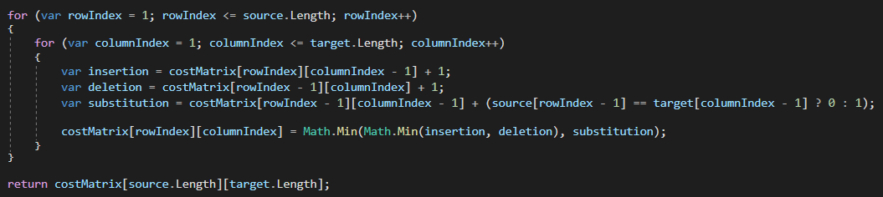
Our baseline – Calculation logic
Row by row, column by column
Time complexity: O(n²)
Notes:
Finally we have the main calculation logic.
Going row by row, column by column, we are grabbing the individual insertion, deletion and substitution costs, finding the minimum value and storing it in our matrix.

Slide 20
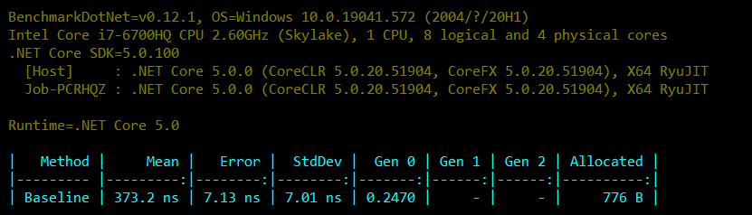
Our baseline
For the calculating the distance of “Saturday” and “Sunday”
Notes:
Benchmarked using .NET 5, our solution doesn’t seem to perform too badly.
In a little under 400 nanoseconds, we calculated the distance between our two strings.
These were two small strings though, how does it work if the strings were a few thousand characters long?

Slide 21
Our baseline
Reasonable performance for short strings
Longer strings need some work
Allocations aren’t great
Notes:
As implied by the Big-O notation on the previous slides, the algorithm doesn’t scale well at all.
To achieve our performance goal, we will use a combination of .NET features and get a better understanding of the algorithm itself.
Let’s start with the algorithm.

Slide 22
Understanding the algorithm (Part 1)
 |  | S | a | t | u | r | d | a | y
 | 0 | 1 | 2 | 3 | 4 | 5 | 6 | 7 | 8
S | 1 | 0 | 1 | 2 | 3 | 4 | 5 | 6 | 7
u | 2
n | 3
d | 4
a | 5
y | 6
Notes:
At any single point in time in the calculation, we only care about the current and previous rows.

Slide 23
Understanding the algorithm (Part 1)
 |  | S | a | t | u | r | d | a | y
 | 0 | 1 | 2 | 3 | 4 | 5 | 6 | 7 | 8
S | 1 | 0 | 1 | 2 | 3 | 4 | 5 | 6 | 7
u | 2 | 1 | 1 | 2 | 2 | 3 | 4 | 5 | 6
n | 3
d | 4
a | 5
y | 6
Notes:
So why do we create a whole matrix for the values?

Slide 24
Understanding the algorithm (Part 1)
 |  | S | a | t | u | r | d | a | y
 | 0 | 1 | 2 | 3 | 4 | 5 | 6 | 7 | 8
S | 1 | 0 | 1 | 2 | 3 | 4 | 5 | 6 | 7
u | 2 | 1 | 1 | 2 | 2 | 3 | 4 | 5 | 6
n | 3 | 2 | 2 | 2 | 3 | 3 | 4 | 5 | 6
d | 4
a | 5
y | 6
Notes:
Instead, we could just alternate between two rows of data.

Slide 25
Understanding the algorithm (Part 1)
Only the current and previous rows matter
Space complexity: O(2(n+1))
 |  | S | a | t | u | r | d | a | y
 | 0 | 1 | 2 | 3 | 4 | 5 | 6 | 7 | 8
S | 1 | 0 | 1 | 2 | 3 | 4 | 5 | 6 | 7
u | 2 | 1 | 1 | 2 | 2 | 3 | 4 | 5 | 6
n | 3 | 2 | 2 | 2 | 3 | 3 | 4 | 5 | 6
d | 4
a | 5
y | 6
Notes:
This would dramatically decrease the memory requirements for the calculation.
While this improvement should not be understated, we can do even better than this.

Slide 26
Understanding the algorithm (Part 1)
With a smarter use of variables, we don’t even need 2 rows
We don’t need the extra +1 to track the first column either.
Space complexity: O(n)
 |  | S | a | t | u | r | d | a | y
 | 0 | 1 | 2 | 3 | 4 | 5 | 6 | 7 | 8
S | 1 | 0
u | 2
n | 3
d | 4
a | 5
y | 6
Notes:
If we had one row, it can represent the deletion costs.
The substitution and insertion costs start from a known point, 0 and 1, so we can use single variables to track that.
Once we calculate a cell, it is a matter of shuffling our insertion, substitution and deletion costs around.

Slide 27
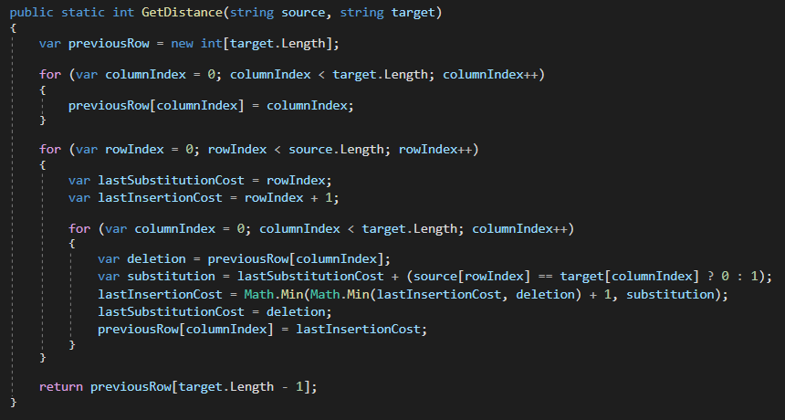
Understanding the algorithm (Part 1)
No jagged array
No LINQ
One less for-loop
Notes:
Here is an example of what that might look like in C#.
While the LINQ usage would have contributed to our allocations, the biggest win here is the lack of the jagged array itself.
We also gain a small benefit from removing one of our data initialization loops.
So, what effect does this have on the allocations?

Slide 28
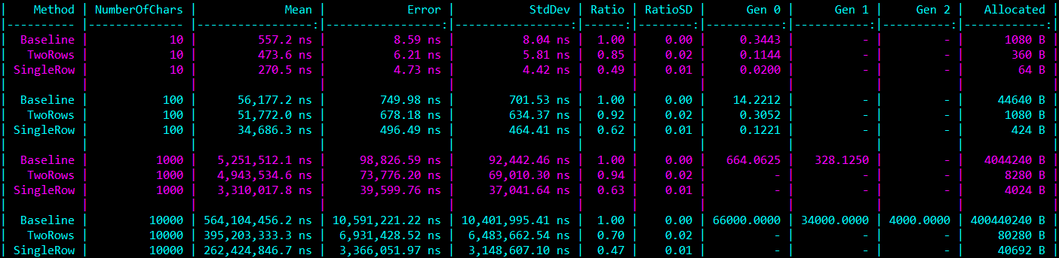
Understanding the algorithm (Part 1)
Single row is 37-53% faster than baseline
For 10,000 characters, single row allocates 39.7KB
For comparison, baseline allocates 381.9MB!
Notes:
Our single row variant allocates significantly less than our baseline.
We have removed over 99.9% of the allocations in our 10,000 character example and the calculation is performed far faster.
All these gains are from taking a closer look at the algorithm and how we could be smarter with it.
For the little memory we are still allocating, we can now use a feature of .NET to remove it entirely: ArrayPool

Slide 29
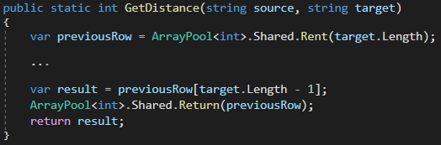
Array Pooling
Our current array is a temporary internal buffer
ArrayPool<T> allows us to temporarily rent an array
We then return the array after use
Notes:
Every call to GetDistance was creating a new array for tracking a row of edit costs.
Instead, we can rent an array from ArrayPool, avoiding the allocation costs associated with creating a new array.
We do our calculation as normal but before we finish, we take our result out of the array and return the rented array.
Returning the array is an important step – it isn’t free memory, we need to return it so other code can use that buffer.
When used properly, the ArrayPool can be extremely useful!

Slide 30
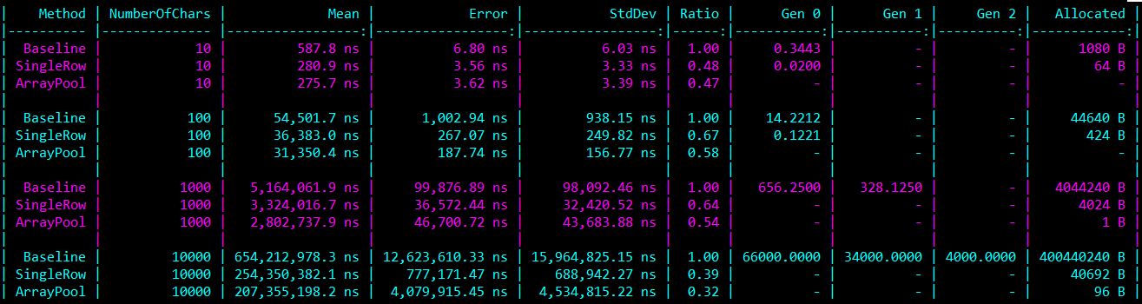
Performance with ArrayPool
Performs 2-18% faster with ArrayPool
Further reading: https://adamsitnik.com/Array-Pool/
Note: Allocations shown in ArrayPool variant are due to a bug with BenchmarkDotNet, see GitHub issue #1542
Notes:
From such a small change to our code, our memory allocations are now gone and we’ve even had a small increase in performance.
ArrayPool has worked great in our scenario though there are some things to keep in mind if you are wanting to use it yourself – there is a great post by Adam Sitnik about ArrayPool which goes into depth about some of the quirks.
Now that our memory issues are effectively solved, let’s continue improving performance by taking another look at the algorithm.

Slide 31
Understanding the algorithm (Part 2)
 |  | S | a | t | u | r | d | a | y
 | 0 | 1 | 2 | 3 | 4 | 5 | 6 | 7 | 8
S | 1 | 0 | 1 | 2 | 3 | 4 | 5 | 6 | 7
u | 2 | 1 | 1 | 2 | 2 | 3 | 4 | 5 | 6
n | 3 | 2 | 2 | 2 | 3 | 3 | 4 | 5 | 6
d | 4 | 3 | 3 | 3 | 3 | 4 | 3 | 4 | 5
a | 5 | 4 | 3 | 4 | 4 | 4 | 4 | 3 | 4
y | 6 | 5 | 4 | 4 | 5 | 5 | 5 | 4 | 3
When the strings have matching prefixes and suffixes, they don’t impact the result
Start from the first different character, finish on the last
Notes:
There are a lot of cells to iterate in our matrix – it would be great if we could reduce it.
It turns out that strings with a common start and end can be trimmed with no change to the result of the calculation.
In the matrix on screen, I’ve highlighted the area with the differences between the strings as well as the outer boundary, representing the insertion and deletion costs.
What we see here is effectively a mini Levenshtein Distance matrix inside what we were already working on.

Slide 32
Understanding the algorithm (Part 2)
 |  | S | a | t | u | r | d | a | y
 | 0 | 1 | 2 | 3 | 4 | 5 | 6 | 7 | 8
S | 1 | 0 | 1 | 2 | 3 | 4 | 5 | 6 | 7
u | 2 | 1 | 1 | 2 | 2 | 3 | 4 | 5 | 6
n | 3 | 2 | 2 | 2 | 3 | 3 | 4 | 5 | 6
d | 4 | 3 | 3 | 3 | 3 | 4 | 3 | 4 | 5
a | 5 | 4 | 3 | 4 | 4 | 4 | 4 | 3 | 4
y | 6 | 5 | 4 | 4 | 5 | 5 | 5 | 4 | 3
 |  | a | t | u | r
 | 0 | 1 | 2 | 3 | 4
u | 1 | 1 | 2 | 2 | 3
n | 2 | 2 | 2 | 3 | 3
Previously 8x6 cells to process
With trimming, 4x2 cells
Notes:
Factoring this in, we shrink the area we need to process by a significant margin.
While not all strings share a common start and end, when they do it can dramatically increase our performance.
Implementing this logic in C# isn’t terribly difficult but there can be a gotcha depending how you go about implementing it.

Slide 33
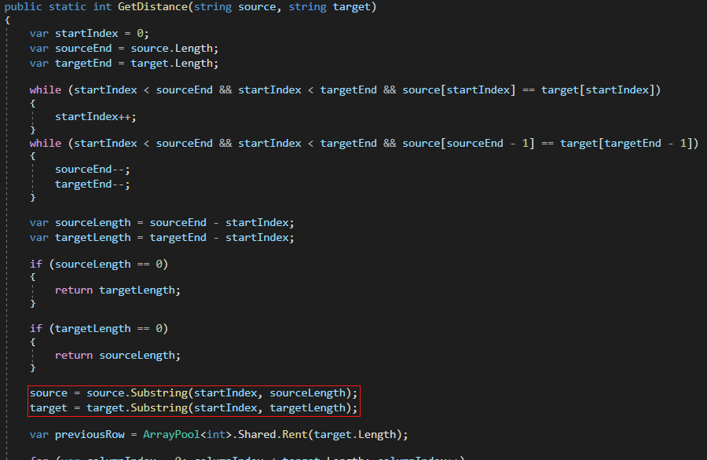
Taking a substring
Using Substring creates a source of allocations
Notes:
On screen now is a fairly basic way in C# to achieve our desired trimming for both the start and end of the strings.
This code, however, isn’t optimal.
Near the bottom of the snippet, we are creating a substring – this is a new source of allocations.
The larger the substring we are making, the more memory we are allocating, working against our earlier efforts to improve memory usage.
Instead with just a few tweaks, we can avoid any allocations by using another feature in .NET

Slide 34
Span-ing Memory
Using Span Slice returns a ReadOnlySpan<char>
No new string means no new allocations
Further reading: https://adamsitnik.com/Span/
Notes:
By switching from Substring to using Span Slice, we can avoid creating a new string on the heap.
This works because a Span is a span of memory – pointers, arrays or in our case, strings.
A Span lives on the stack and just points to specific segments of memory.
So when we slice it, all we are doing is creating a new Span with a new offset and length.
The behaviour of Span works well in our use case, we don’t need a new string specifically, we just want a slice of the string to work with.

Slide 35
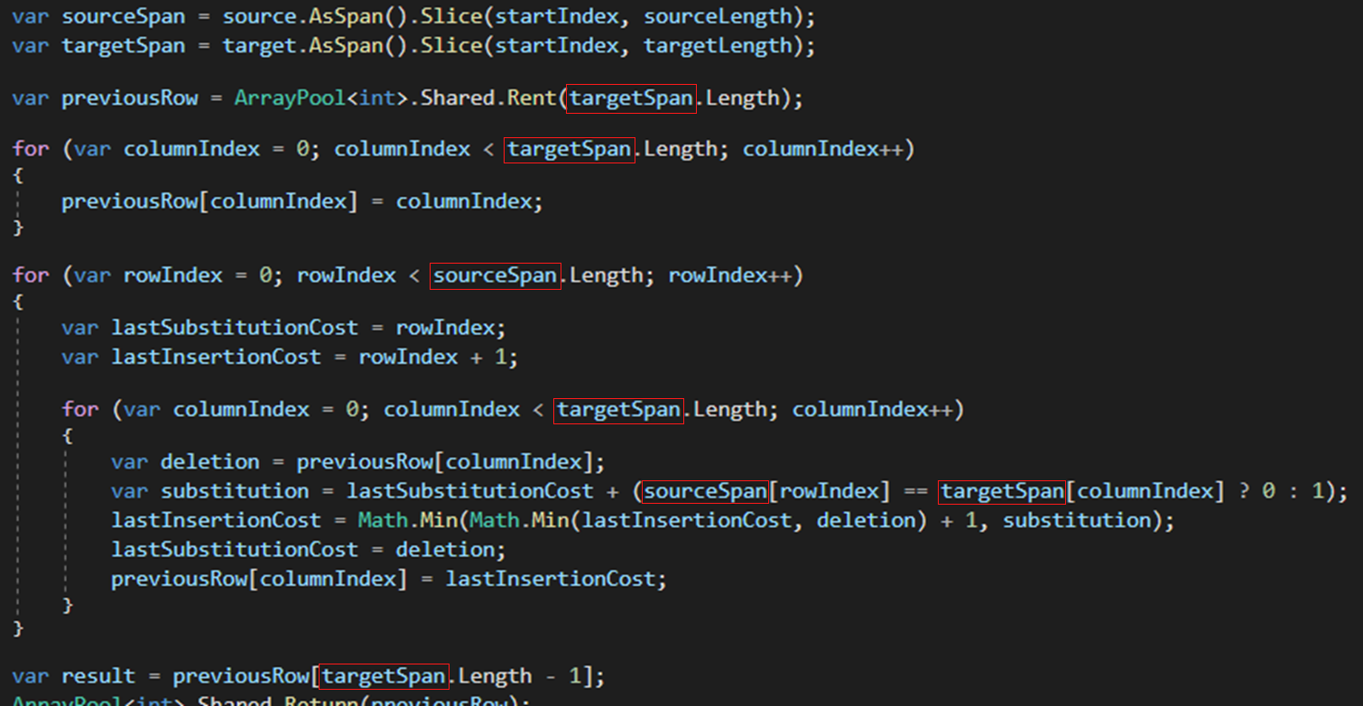
Taking a slice
Notes:
We keep all of the main trimming code shown earlier with our changes only starting from our slicing instead of using substring.
Because we are using a new variable, we need to change a few references in the rest of our code.
That said, it is otherwise is a drop-in replacement as Span supports indexers and a Length property.

Slide 36
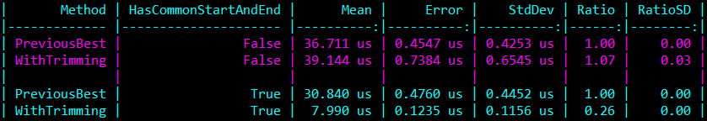
The performance of trimming
No common start/end: Trimming is slightly slower
Common start/end: Trimming is much faster
Notes:
The performance of trimming will drastically depend on the input strings.
In this specific benchmark, there are 2 variations of 100 character strings – where they do or don’t share a common start and end.
When they don’t share one, performance is slightly worse for our trimming variant.
This is to be expected, we are doing extra processing work which turns out to have no benefit.
When they do share one, it can help the calculation perform much faster.
You might have noticed that our previous variant without trimming support also performs a little faster when strings have a common start and end.
This relates to branch predictability.

Slide 37
Let’s talk branch prediction
Our performance is tied to how predictable the data is
The more predictable, the better the performance
Notes:
The performance of Levenshtein Distance can vary drastically by how predictable the data is.
This is because our code has a LOT of branches and the larger the string, the more branches that are processed.
We can enable some hardware counters to see how many branch instructions and branch mispredictions we have to understand the impact of our branches.
While there are limitations to the accuracy of the hardware counters available, we can still get a general idea of how the performance characteristics change.
What we can see though is that our slowest test case, the one with random data, has the most branch mispredictions.

Slide 38
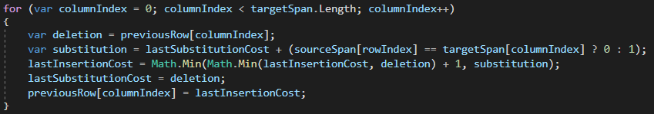
Let’s talk branch prediction
Our inner loop has 3 branches each iteration
1x Equality check between source and target characters
2x Math.Min operations
Notes:
As a reminder of our branching situation, this is our inner loop of the calculation logic.
We have 3 branches, 1 for checking the current characters between the 2 strings and 2 for doing our minimum value logic.
These branches are run on every iteration of the loop.

Slide 39
The performance impact of branches
In a 10,000-character comparison:
Outer loop runs 10,000 times
Inner loop runs 100,000,000 times!
We can’t make the data more predictable, but we can reduce the number of branch predictions required
Notes:
The problem with our branches is how often our inner loop is called and the potential randomness of our data.
The longer the strings are comparing, the worse our inner loop performs due to those branches.
We can reduce the number of branches we process because the Levenshtein Distance algorithm has another trick up it’s sleeve…

Slide 40
Understanding the algorithm (Part 3)
We need lowest value of the insertion, deletion and substitution
When two characters are equal, the lowest value is always the substitution
 |  | S | a | t | u | r | d | a | y
 | 0 | 1 | 2 | 3 | 4 | 5 | 6 | 7 | 8
S | 1 | 0 | 1 | 2 | 3 | 4 | 5 | 6 | 7
u | 2 | 1 | 1 | 2 | 2 | 3 | 4 | 5 | 6
n | 3 | 2 | 2 | 2 | 3 | 3 | 4 | 5 | 6
d | 4 | 3 | 3 | 3 | 3 | 4 | 3 | 4 | 5
a | 5 | 4 | 3 | 4 | 4 | 4 | 4 | 3 | 4
y | 6 | 5 | 4 | 4 | 5 | 5 | 5 | 4 | 3
Notes:
The algorithm requires the lowest of the insertion, deletion and substitution.
On screen I’ve highlighted all of the cells where two characters match.
Remembering the rules for calculating the distance, we only add one to the substitution cost if the characters are different.
Insertion and deletion costs on the other hand, they always have one added to them.
In all the cases here where the characters are the same, their substitution cost is the lowest value.
Knowing that, why do we do two Math.Min calls when characters are equal?
Instead we can use the substitution cost directly.

Slide 41
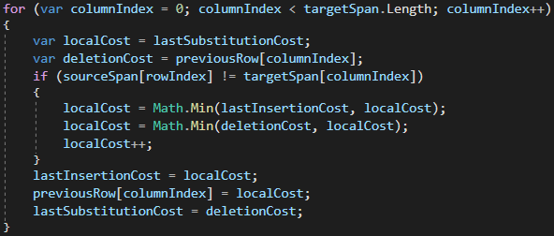
Understanding the algorithm (Part 3)
Wrap the Math.Min calls in an if-statement
Equal characters skip the Math.Min calls
Notes:
Replacing our ternary operator with a full if-statement for our character comparisons, we can wrap our Math.Min calls.
This makes our best case, where the characters are equal, have 2 fewer branches.
Our worst case, where the characters are not equal, still has the same number of branches.

Slide 42
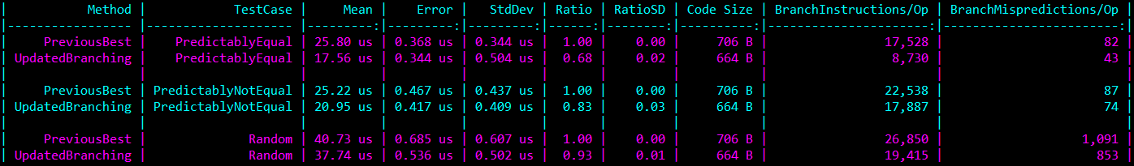
Understanding the algorithm (Part 3)
Our predictably equal path has far less branch instructions
With less branches, there is less to mispredict
Notes:
Performance wise, we are seeing a measurable speedup across the board.
The hardware counters, while remembering their accuracy limitations, show a large difference on our “Predictably Equal” test case.
Strangely there is also a speed up on the “Predictably Not Equal” path though there should be no less branches on that path.
The thing about optimizing on this level is that we can having cascading changes with how the JIT processes our code.
We can see this to some extent with the additional “Code Size” column in the benchmark results.
“Code Size” is the total size of all of the CPU instructions required to execute our code.
Our update version has 42 less bytes of instructions and all we did we re-organise the code.

Slide 43
What the JIT?!
Roslyn Compiler: C# IL
RyuJIT: IL Assembly
Tools to view JIT generated assembly:
Disamo (VS2019 extension)
JitPad (Standalone app)
SharpLab (Website)
BenchmarkDotNet (Disassembly Diagnoser)
Notes:
To understand what the impact is of the JIT optimizations, we need to see what the JIT is generating.
There are a few ways we can view the JIT’s generated assembly code like SharpLab or BenchmarkDotNet’s disassembly diagnoser.
With access to the assembly code, we can start to see how small impacts to our C# code affects the JIT.

Slide 44
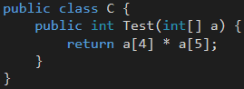
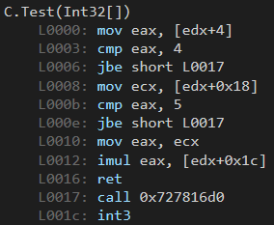
Example: Our affect on the JIT
The assembly output shows bounds checking applied twice
Notes:
Here is a short example, unrelated to Levenshtein Distance, to show how small changes can affect our generated assembly.
On the left, we are accessing two array items and multiplying the results.
You might think the right would then just access the values and multiply the result.

Slide 45
Example: Our affect on the JIT
The assembly output shows bounds checking applied twice
Notes:
Instead we have two branches indicated by the jump instruction labelled “jbe”.

Slide 46
Example: Our affect on the JIT
The assembly output shows bounds checking applied twice
Notes:
You can see both jump instructions go to the line “L0017”, a call instruction.
The branches and that call are all to do one thing, bounds checking.
What if we changed our C# code slightly, what if we swapped the 4 and 5 around.

Slide 47

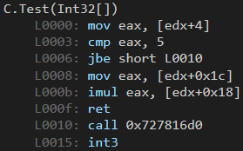
Example: Our affect on the JIT
Only one bounds check in the assembly output
Notes:
When swapped, we have a smaller assembly output with one less bounds check.
It can do this because knowing that it can access index 5 correctly, it can access index 4 without needing to check.
This is what I mean by small changes in our code having larger changes in the JIT output.
This output is arguably faster for having one less branch and less instructions overall.
Now we’ve seen the impact of small changes to our C# code on the JIT, let’s look at an example in our calculation logic where the JIT could do with some help.

Slide 48
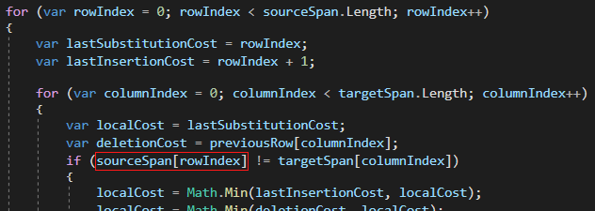
Source character optimization
The JIT doesn’t optimize our sourceSpan reference
Notes:
During the calculation we are comparing a character from the source and target strings together.
The source character is determined by the outer loop whereas the target character is determined by the inner loop.
Our C# code though accesses the source character in the inner loop.
The JIT however doesn’t notice this – leaving our data access in an inefficient position.
With only so much time to optimize code and only so many patterns it can recognise, cases like this might simply not be optimized.
We need to be mindful of how we write code as the JIT can only do so much.
So in cases like this, we should give the JIT a hand.

Slide 49
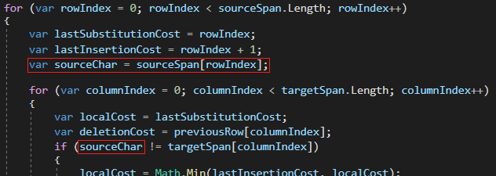
Source character optimization
Changes only once per outer-loop iteration
Notes:
From our business logic perspective, we are doing the exact same operation however now we are being mindful of our usage.
In our current suite of benchmarks, we can pick up a small change in both performance and code size.

Slide 50
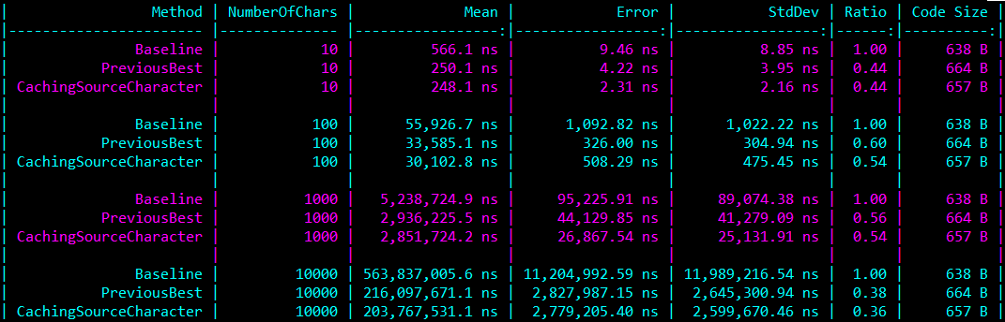
Source character optimization
1-10% faster than previous best
Code size is 7 bytes smaller
Notes:
The performance difference is small however will scale with larger target strings.
The change also allowed the JIT to tweak other related parts of the assembly code allowing a slight reduction in code size.
For a bigger increase in performance, let’s look at something a little more unsafe.

Slide 51

Notes:
Pointers - let’s change our use of spans as well as our rented array to be accessed via pointers instead.
Pointers automatically make things faster right?

Slide 52
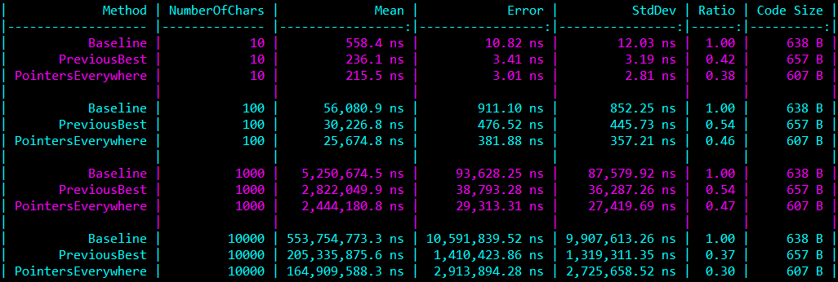
Pointers on all data access
9-20% faster than previous best
Code size is 50 bytes smaller
Notes:
The short answer is yes, pointers did automatically make our code faster and even decreased the code size.
The downside is that are code is now unsafe – our performance improvement is primarily coming from the lack of bounds checking that now occurs.
If we write to the wrong memory location, we can easily corrupt the program – I’ve had this happen numerous times while doing my original research into performance improvements for Levenshtein Distance.
With that in mind, it is a good idea to have extensive testing around the use of pointers just to make sure you don’t corrupt your application. Going beyond pointers, let’s look at using hardware intrinsics to keep boosting our performance.

Slide 53
Hardware Intrinsics
CPUs can have “processor supplementary capabilities” that extend the instructions available from the base architecture
x86 architecture supplementary capabilities
MMX
SSE/SSE2/SSE3
AVX/AVX2
AVX-512
Etc
Notes:
Hardware intrinsics is about accessing specialised instructions on a CPU that can accelerate specific workloads.
These instructions come from additional capabilities of specific CPUs that extend a base architecture.
Since .NET Core 3.0, we can access these additional instructions to accelerate performance in our applications.
The majority of these instructions relate to a concept called Single Instruction, Multiple Data – or SIMD.

Slide 54
Single Instruction, Multiple Data (SIMD)
We can work on multiple values in the same CPU instruction
Example: Adding 8 values in one operation
0 | 1 | 2 | 3 | 4 | 5 | 6 | 7
+ | + | + | + | + | + | + | +
2 | 1 | 1 | 2 | 2 | 3 | 3 | 1
= | = | = | = | = | = | = | =
2 | 2 | 3 | 5 | 6 | 8 | 9 | 8
Notes:
SIMD is a way that we can perform an action to a set of data at once, rather than individually.
Work is performed on a vector so in the example, we have two 8-value vectors and we can add them together in a single operation.
In Levenshtein Distance, there are a couple of ways we can use it though there are some caveats.

Slide 55
Single Instruction, Multiple Data (SIMD)
Extremely useful when code is well suited for vectorization
Levenshtein Distance is not well suited for vectorization
 |  | S | a | t | u | r | d | a | y
 | 0 | 1 | 2 | 3 | 4 | 5 | 6 | 7 | 8
S | 1
u | 2
n | 3
d | 4
a | 5
y | 6
Notes:
The core problem comes down to the fact that for us to be able to do vector processing, we’d ideally need a full vector of values.
For Levenshtein Distance, this is difficult to do in the main calculation as we don’t know all the values we need for a vector at the same time.
Let’s walk through the calculation if we tried to vectorize it in the same way we’ve been processing it currently.

Slide 56
Single Instruction, Multiple Data (SIMD)
We could fill substitution costs into a vector
 |  | S | a | t | u | r | d | a | y
 | 0 | 1 | 2 | 3 | 4 | 5 | 6 | 7 | 8
S | 1
u | 2
n | 3
d | 4
a | 5
y | 6
Notes:
Highlighted is the substitution costs for the first 4 cells.
Loading that into a vector isn’t a problem, we know all those values ahead of time.

Slide 57
Single Instruction, Multiple Data (SIMD)
We could fill deletion costs into a vector
 |  | S | a | t | u | r | d | a | y
 | 0 | 1 | 2 | 3 | 4 | 5 | 6 | 7 | 8
S | 1
u | 2
n | 3
d | 4
a | 5
y | 6
Notes:
Similarly with deletion costs – we can load those into a vector no problem.
How about the insertion costs?

Slide 58
Single Instruction, Multiple Data (SIMD)
Insertion costs depend on the adjacent cell
We can’t add to a vector the values we don’t already know
 |  | S | a | t | u | r | d | a | y
 | 0 | 1 | 2 | 3 | 4 | 5 | 6 | 7 | 8
S | 1
u | 2
n | 3
d | 4
a | 5
y | 6
Notes:
Insertion costs become our problem as while we know the first insertion cost, we don’t know the next 3 to fully load our vector.
Let’s pretend we had the next 3 insertion values…

Slide 59
Single Instruction, Multiple Data (SIMD)
Insertion costs depend on the adjacent cell
We can’t add to a vector the values we don’t already know
 |  | S | a | t | u | r | d | a | y
 | 0 | 1 | 2 | 3 | 4 | 5 | 6 | 7 | 8
S | 1 | 0 | 1 | 2
u | 2
n | 3
d | 4
a | 5
y | 6
Notes:
So now with all 3 vectors we can begin calculating but wait a minute… we have 3 of our 4 values we were going to calculate anyway.
What this means is that only the 4th value in our resulting vector would be a value we didn’t already calculate – this doesn’t seem to be useful at all.
All hope isn’t lost though, we can still make use of vectorization.

Slide 60
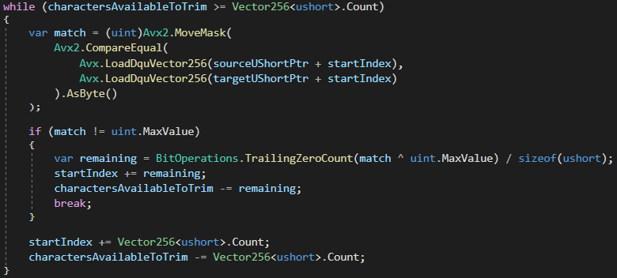
SIMD: Improving trimming logic
Up-to 16 characters checked at a time
Notes:
Our trimming logic can take advantage of vectorization as we can use it to compare multiple characters at a time.
The snippet here is a small part of the larger solution however gives the gist of our changes.
Using AVX2, a capability for modern x86 CPUs, we load our strings into two 256-bit vectors, allowing us to compare 16 characters at once.
We continue with more AVX2 instructions, comparing values and getting us a single “match” value.
If any of the characters are not equal, we use some bit operations to find the final number of characters we can trim.
I’m simplifying this for brevity however it is worth noting a number of specific additional considerations.
Not all CPUs support all instructions – what the snippet doesn’t show is a defensive check to confirm AVX2 support, falling back without it.
Ideally falling back to use 128-bit vectors with an older instruction set.
These are some of the things to keep in mind if you are using hardware intrinsics.

Slide 61
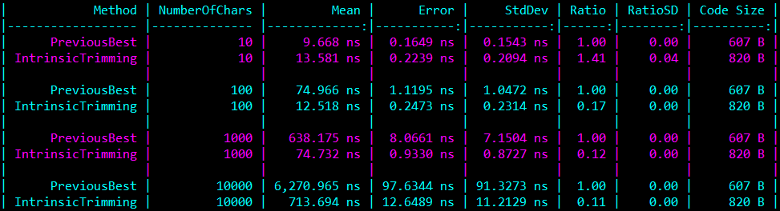
SIMD: Improving trimming logic
10-character string trimming 41% slower
100+ character string trimming >=83% faster
Notes:
This is a specialised benchmark for string trimming where all characters are trimmed.
While we have a small performance regression at 10 characters, we have hugely increased our performance in any strings that are longer.
Just look at how much faster our 1000 or 10000 character trimming has performed.
Depending on your workload, with the right use of SIMD and other hardware intrinsics, you can have huge performance gains.
It is worth noting, however, that our code size has increased quite a bit.
Now for something more unconventional, using SIMD in a way it likely isn’t intended.

Slide 62
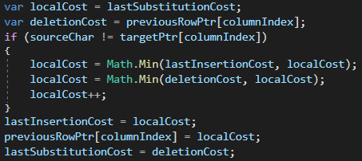
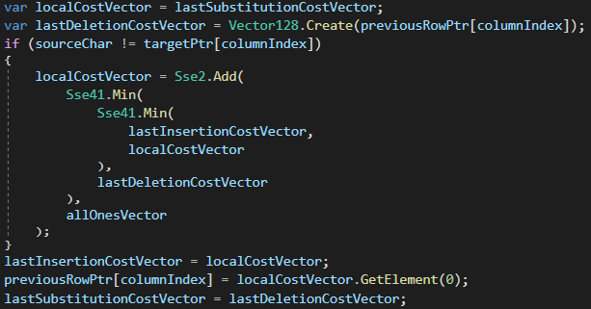
SIMD: Using it improperly
Before
After (Intrinsic Calculation)
Updated version no longer has branches for calculating the minimum values for vectors
Notes:
I said earlier that the main calculation, with the way we process it row-by-row, can’t benefit from SIMD because we can’t load the full vector.
While that is true, it is somewhat a half truth – there are ways we can still benefit if we try hard enough.
On screen is the before and after of swapping out the core calculation logic for Levenshtein Distance.
There is a lot of vectors being used but if you look carefully, the vectors are loaded with the same value in all positions.
It is equally as wasteful computationally however follows our previous logic closely and ends up removing the minimum value branches for us.

Slide 63
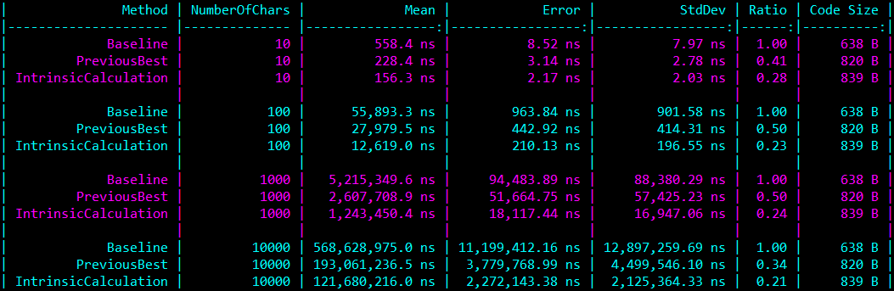
SIMD: Using it improperly
~27% faster than our previous best implementation
~78% faster than our baseline
Notes:
With less branches for the CPU to worry about, our code still ends up improving in performance.
From 10 character strings through to 10000 character strings, it beats our previous best and crushes our baseline.
Still though, what if we need to work on bigger strings?
This is where we take everything we learned about Levenshtein Distance so far and make it multi-threaded.

Slide 64
For even larger strings: Multi-threading
We can split the work across multiple threads if we break up the calculation
 |  | S | a | t | u | r | d | a | y
 | 0 | 1 | 2 | 3 | 4 | 5 | 6 | 7 | 8
S | 1
u | 2
n | 3
d | 4
a | 5
y | 6
Notes:
To help demonstrate how we can do multi-threading, I’ve split the matrix into two regions, showing how two threads would work.

Slide 65
For even larger strings: Multi-threading
We can split the work across multiple threads if we break up the calculation
 |  | S | a | t | u | r | d | a | y
 | 0 | 1 | 2 | 3 | 4 | 5 | 6 | 7 | 8
S | 1 | 0 | 1 | 2 | 3
u | 2
n | 3
d | 4
a | 5
y | 6
Notes:
At the start of calculating, we need to complete the first row in the first region in a single thread.

Slide 66
For even larger strings: Multi-threading
We can split the work across multiple threads if we break up the calculation
 |  | S | a | t | u | r | d | a | y
 | 0 | 1 | 2 | 3 | 4 | 5 | 6 | 7 | 8
S | 1 | 0 | 1 | 2 | 3 | 4
u | 2 | 1 | 1 | 2
n | 3
d | 4
a | 5
y | 6
Notes:
Once that row is completed, that thread can continue on its next row.
At the same time, the next region over can start on the first row.

Slide 67
For even larger strings: Multi-threading
We can split the work across multiple threads if we break up the calculation
 |  | S | a | t | u | r | d | a | y
 | 0 | 1 | 2 | 3 | 4 | 5 | 6 | 7 | 8
S | 1 | 0 | 1 | 2 | 3 | 4 | 5 | 6 | 7
u | 2 | 1 | 1 | 2 | 2 | 3 | 4 | 5 | 6
n | 3 | 2 | 2 | 2 | 3 | 3 | 4 | 5 | 6
d | 4 | 3 | 3 | 3 | 3
a | 5 | 4 | 3 | 4 | 4
y | 6 | 5 | 4 | 4 | 5
Notes:
This process works this way because of the dependency on insertion and substitution costs across regions.
The right thread needs the left thread to process the row first.

Slide 68
For even larger strings: Multi-threading
Each thread needs to share a buffer between another thread
Access to this buffer must be done safely to avoid memory corruption
 |  | S | a | t | u | r | d | a | y
 | 0 | 1 | 2 | 3 | 4 | 5 | 6 | 7 | 8
S | 1 | 0 | 1 | 2 | 3 | 4 | 5 | 6 | 7
u | 2 | 1 | 1 | 2 | 2 | 3 | 4 | 5 | 6
n | 3 | 2 | 2 | 2 | 3 | 3 | 4 | 5 | 6
d | 4 | 3 | 3 | 3 | 3
a | 5 | 4 | 3 | 4 | 4
y | 6 | 5 | 4 | 4 | 5
Notes:
Adjacent regions need to share a buffer between threads to access the insertion and substitution costs.
The left thread writes to it, the right thread reads from it.
When implemented well, we can scale across CPUs with many cores, allowing processing of huge strings in a reasonable time.

Slide 69
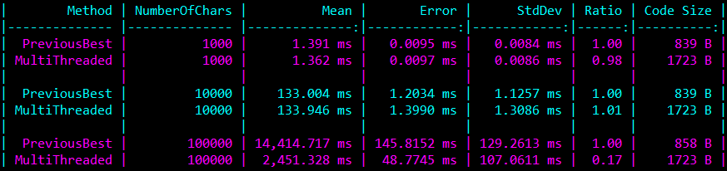
For even larger strings: Multi-threading
Configured for minimum 10,000 characters per thread
Performance at 100,000 characters
Previous Best: 14.4ms
Multi-threaded: 2.4ms (83% faster)
Notes:
This multi-threaded variant is configured for a minimum of 10,000 characters per thread, avoiding overhead on smaller strings.
It still takes advantage of everything else we’ve talked about – a single row data structure, using ArrayPool to reduce allocations, with branch improvements, use of pointers, and our vectorization tricks.
On my test machine with 4 cores and 8 threads, the 100,000 character benchmark uses 8 threads which lead to an 83% performance improvement.
On a machine with more cores, it would likely be possible to scale this further for handling larger strings.

Slide 70
There is more performance left to get
More assembly fine-tuning
Using SIMD for data initialization
Loop unrolling
Proper SIMD calculation logic (diagonal calculation)
Notes:
Beyond everything I’ve talked about so far, there are still other ways we can improve performance.
We can fine tune our assembly output, looking up what instructions perform the fastest, and massage our C# the right way so the JIT generates what we want.
Our data initialization, we could write a vector of data to a pointer, filling the row 8 values at a time.
Loop unrolling can also be effective, while there are certain things to be aware of when doing so, it further reduces branches, increasing performance.
Or a really interesting technique of processing our data in diagonally, allowing us to use vectors to their full advantage.
I can’t fit them all into a single talk so let’s finish up on some key points to improve performance in your own code.

Slide 71
Performance Takeaways
Have a performance goal
Measure changes
Understand the algorithm
Know the tools you have available (e.g. ArrayPool)
Notes:
Have a performance goal – this is really important, you need to know why you are optimizing.
Our goal from the outset was for handling very large strings, now we can tackle strings over 100,000 characters long.
If we were writing this for a spell checking application, the later optimizations are mostly not needed.
When you know your goal though, it is important to keep measuring your changes on your path to get there.
The various benchmarks throughout this talk showed measurable performance and allocation changes so we knew we were making progress.
Our initial progress came from gaining a better understanding of the algorithm – while I might have been talking Levenshtein Distance, think about the code you are working on.
Reframing the problem you are tackling with an algorithm might give you insights to dramatically improve performance before doing anything exotic.
Finally though, knowing the tools you have available can help unlock additional performance.
We removed allocations with ArrayPool, avoided other allocations with Span and gained even more performance with hardware intrinsics.
No doubt there are new tools and features coming to the .NET runtime that will continue to help us improve performance in our applications too.

Slide 72
Related Links
Quickenshtein – a .NET Levenshtein Distance Calculator https://github.com/Turnerj/Quickenshtein
Levenshtein Distance benchmarks (from this presentation) https://github.com/Turnerj/LevenshteinBenchmarks
Notes:
Finishing up, you can find my highly optimized version of Levenshtein Distance, called Quickenshtein, on GitHub – it has every optimization I’ve mentioned today including the ones I couldn’t cover in detail.
It is quite possibly the fastest .NET implementation for calculating Levenshtein Distance.
Additionally, all the benchmarks and code from this talk are available on GitHub.

Slide 73

Thanks for joining!
Notes:
Thanks for joining in on my talk!

